Slide 1

Artificial Intelligence
Reinforcement Learning
Instructors: Fatemeh Mansoori
University of Isfahan
[These slides were created by Dan Klein and Pieter Abbeel for CS188 Intro to AI at UC Berkeley. All CS188 materials are available at http://ai.berkeley.edu.]
Notes:
Please retain proper attribution, including the reference to ai.berkeley.edu. Thanks!

Slide 2
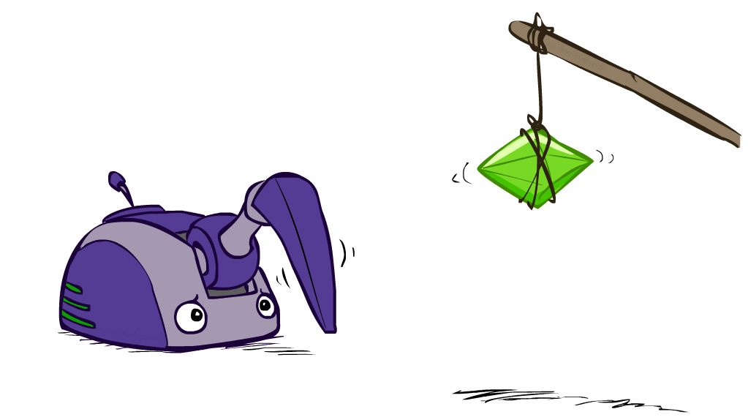
Reinforcement Learning

Slide 3
Reinforcement Learning
Agent
State: s
Reward: r
Actions: a
Environment
Basic idea:
Receive feedback in the form of rewards
Agent’s utility is defined by the reward function
Must (learn to) act so as to maximize expected rewards
All learning is based on observed samples of outcomes!
Notes:
Show robot-soccer learning to walk videos (UT Austin):
? Show snake robot:

Slide 4
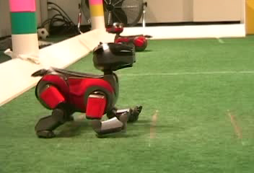

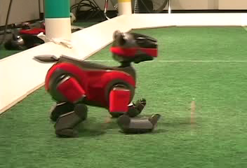
Example: Learning to Walk
Initial
A Learning Trial
After Learning [1K Trials]
[Kohl and Stone, ICRA 2004]

Slide 5

Example: Learning to Walk
Initial
[Kohl and Stone, ICRA 2004]
[Video: AIBO WALK – initial]

Slide 6
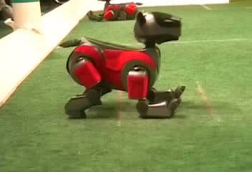
Example: Learning to Walk
Training
[Kohl and Stone, ICRA 2004]
[Video: AIBO WALK – training]

Slide 7

Example: Learning to Walk
Finished
[Kohl and Stone, ICRA 2004]
[Video: AIBO WALK – finished]

Slide 8

Example: Toddler Robot
[Tedrake, Zhang and Seung, 2005]
[Video: TODDLER – 40s]

Slide 9
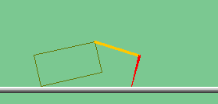
The Crawler!
[Demo: Crawler Bot (L10D1)] [You, in Project 3]
Notes:
At times no reward accumulated at all, just sitting still

Slide 10

Video of Demo Crawler Bot

Slide 11
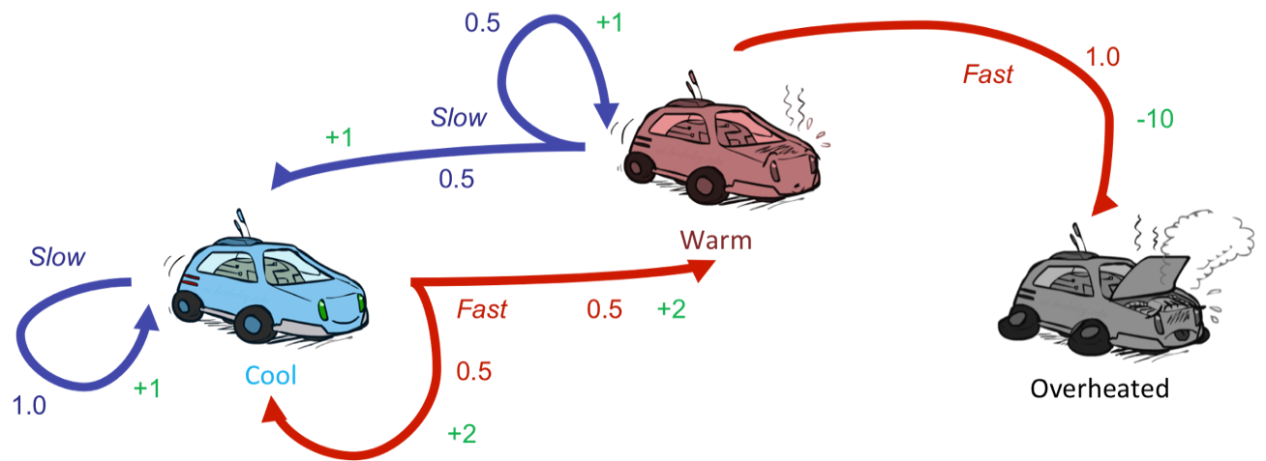
Reinforcement Learning
Still assume a Markov decision process (MDP):
A set of states s ∈ S
A set of actions (per state) A
A model T(s,a,s’)
A reward function R(s,a,s’)
Still looking for a policy π(s)
New twist: don’t know T or R
I.e. we don’t know which states are good or what the actions do
Must actually try out actions and states to learn

Slide 12
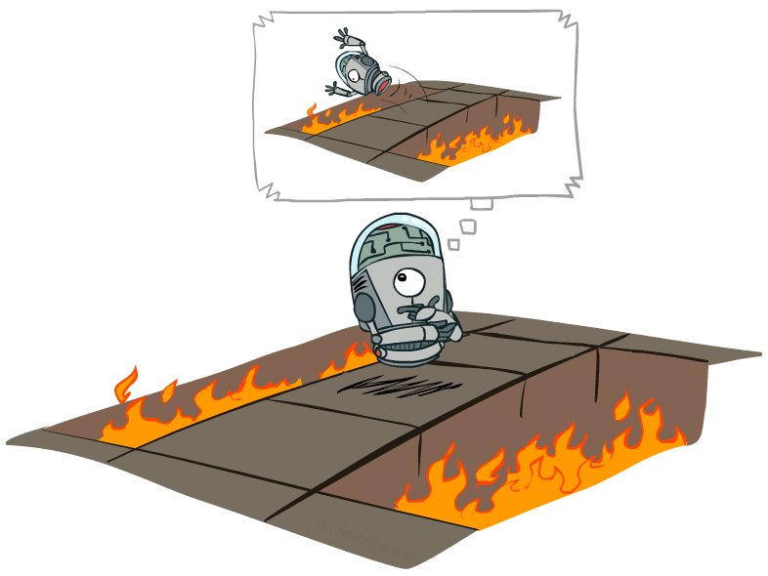
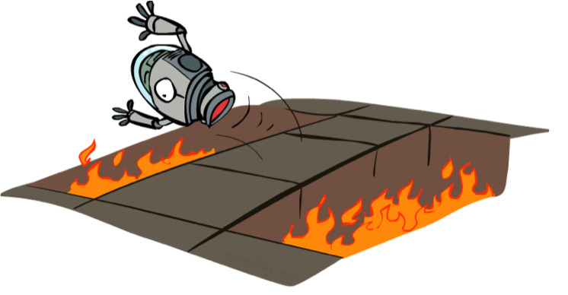
Offline (MDPs) vs. Online (RL)
Offline Solution
Online Learning

Slide 13

Model-Based Learning

Slide 14

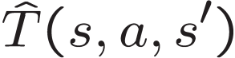

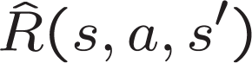
Model-Based Learning
Model-Based Idea:
Learn an approximate model based on experiences
Solve for values as if the learned model were correct
Step 1: Learn empirical MDP model
Count outcomes s’ for each s, a
Normalize to give an estimate of
Discover each when we experience (s, a, s’)
Step 2: Solve the learned MDP
For example, use value iteration, as before

Slide 15
Example: Model-Based Learning
Input Policy π
Observed Episodes (Training)
Learned Model
Episode 1
Episode 2
T(s,a,s’).
T(B, east, C) = 1.00
T(C, east, D) = 0.75
T(C, east, A) = 0.25
…
R(s,a,s’).
R(B, east, C) = -1
R(C, east, D) = -1
R(D, exit, x) = +10
…
 | A
B | C | D
 | E
B, east, C, -1
C, east, D, -1
D, exit, x, +10
B, east, C, -1
C, east, D, -1
D, exit, x, +10
Episode 3
Episode 4
E, north, C, -1
C, east, D, -1
D, exit, x, +10
E, north, C, -1
C, east, A, -1
A, exit, x, -10
Assume: γ = 1

Slide 16
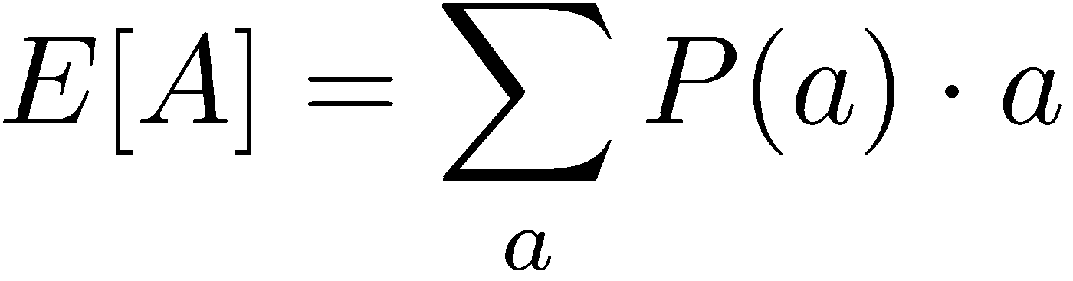
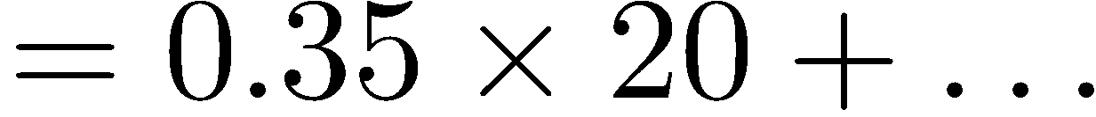
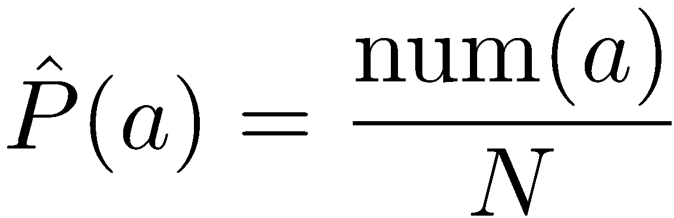
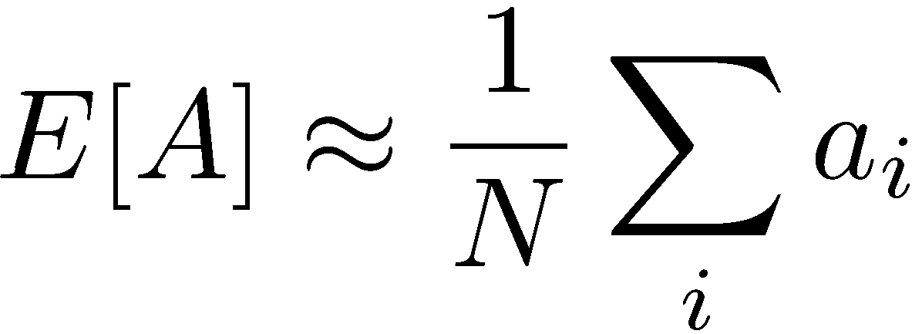
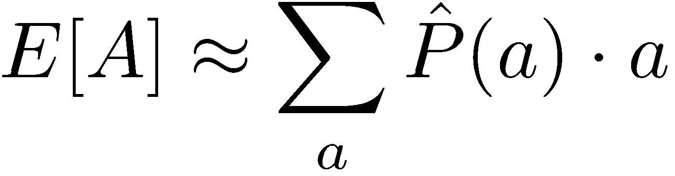
Example: Expected Age
Goal: Compute expected age of AI class students
Known P(A)
Without P(A), instead collect samples [a₁, a₂, … a_{N}]
Unknown P(A): “Model Based”
Unknown P(A): “Model Free”
Why does this work? Because eventually you learn the right model.
Why does this work? Because samples appear with the right frequencies.

Slide 17
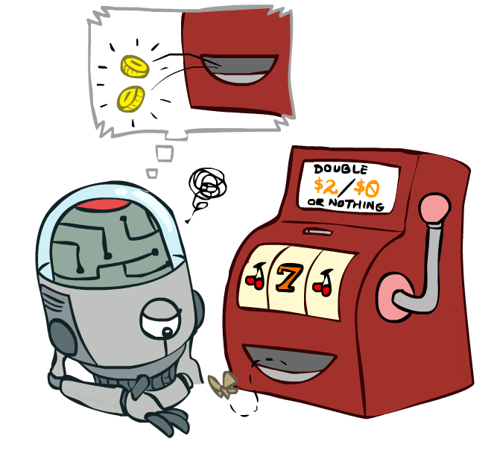
Model-Free Learning

Slide 18
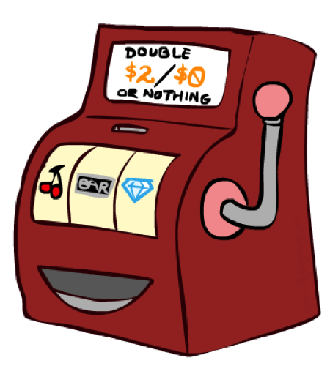
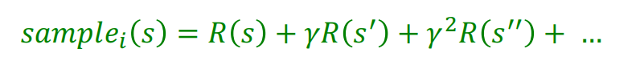
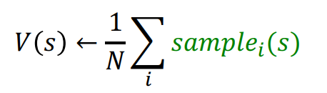
Direct Evaluation
Goal: Compute values for each state under π
Idea: Average together observed sample values
Act according to π
Every time you visit a state, write down what the sum of discounted rewards turned out to be
Average those samples
This is called direct evaluation

Slide 19
Example: Direct Evaluation
Input Policy π
Observed Episodes (Training)
Output Values
Episode 1
Episode 2
 | A
B | C | D
 | E
 | A
B | C | D
 | E
B, east, C, -1
C, east, D, -1
D, exit, x, +10
B, east, C, -1
C, east, D, -1
D, exit, x, +10
-10
+8
+4
+10
Episode 3
Episode 4
-2
E, north, C, -1
C, east, D, -1
D, exit, x, +10
E, north, C, -1
C, east, A, -1
A, exit, x, -10
Assume: γ = 1

Slide 20
Problems with Direct Evaluation
What’s good about direct evaluation?
It’s easy to understand
It doesn’t require any knowledge of T, R
It eventually computes the correct average values, using just sample transitions
What bad about it?
It wastes information about state connections
Each state must be learned separately
So, it takes a long time to learn
Output Values
 | A
B | C | D
 | E
-10
+8
+4
+10
-2
If B and E both go to C under this policy, how can their values be different?

Slide 21

Why Not Use Policy Evaluation?
s
Simplified Bellman updates calculate V for a fixed policy:
Each round, replace V with a one-step-look-ahead layer over V
This approach fully exploited the connections between the states
Unfortunately, we need T and R to do it!
Key question: how can we do this update to V without knowing T and R?
In other words, how to we take a weighted average without knowing the weights?
π(s)
s, π(s)
s, π(s),s’
s’

Slide 22
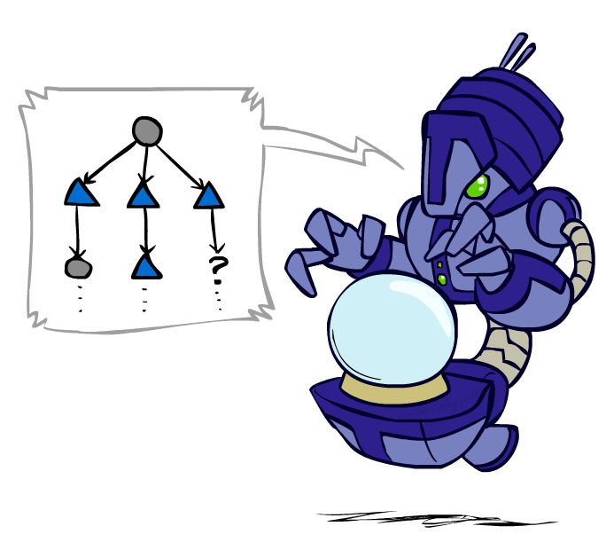
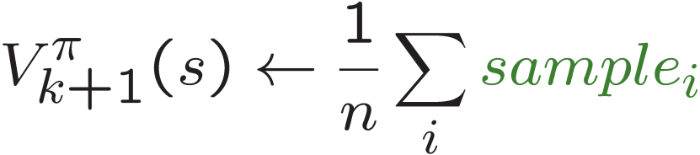
Sample-Based Policy Evaluation?
We want to improve our estimate of V by computing these averages:
Idea: Take samples of outcomes s’ (by doing the action!) and average
s
π(s)
s, π(s)
s, π(s),s’
s₁'
s₂'
s'
s₃'
Almost! But we can’t rewind time to get sample after sample from state s.

Slide 23
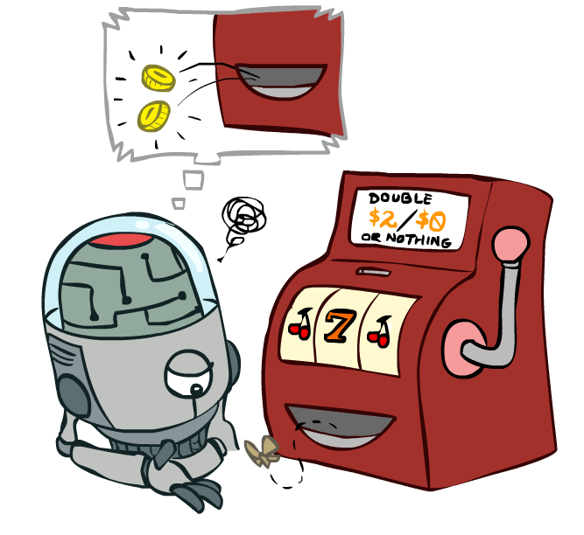
Temporal Difference Learning

Slide 24
Temporal Difference Learning
Big idea: learn from every experience!
Update V(s) each time we experience a transition (s, a, s’, r)
Likely outcomes s’ will contribute updates more often
Temporal difference learning of values
Policy still fixed, still doing evaluation!
Move values toward value of whatever successor occurs: running average
s
π(s)
s, π(s)
s’
Sample of V(s):
Update to V(s):
Same update:

Slide 25
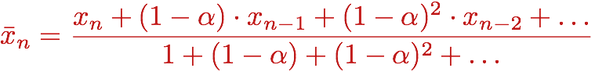
Exponential Moving Average
Exponential moving average
The running interpolation update:
Makes recent samples more important:
Forgets about the past (distant past values were wrong anyway)
Decreasing learning rate (alpha) can give converging averages

Slide 26
Example: Temporal Difference Learning
States
Observed Transitions
B, east, C, -2
C, east, D, -2
 | A
B | C | D
 | E
 | 0
0 | 0 | 8
 | 0
 | 0
-1 | 0 | 8
 | 0
 | 0
-1 | 3 | 8
 | 0
Assume: γ = 1, α = 1/2

Slide 27
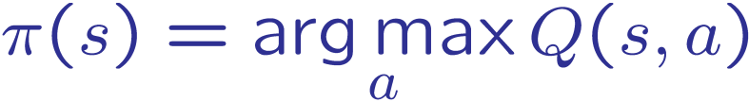
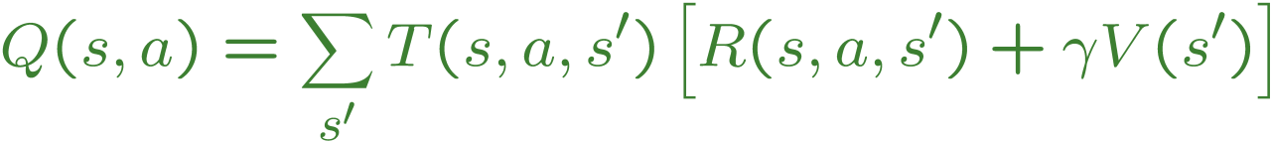
Problems with TD Value Learning
TD value leaning is a model-free way to do policy evaluation, mimicking Bellman updates with running sample averages
However, if we want to turn values into a (new) policy, we’re sunk:
Idea: learn Q-values, not values
Makes action selection model-free too!
s
a
s, a
s,a,s’
s’

Slide 28
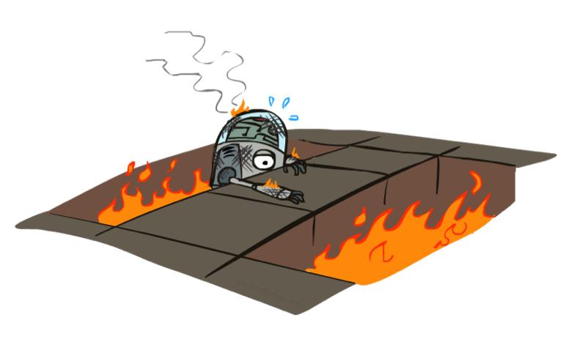
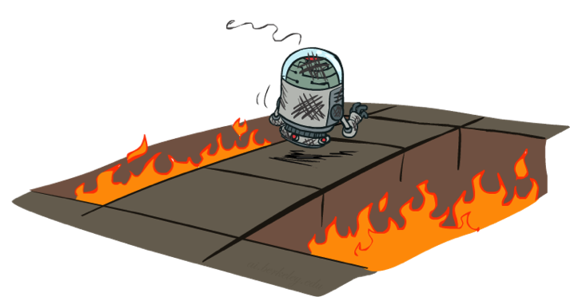
Active Reinforcement Learning

Slide 29
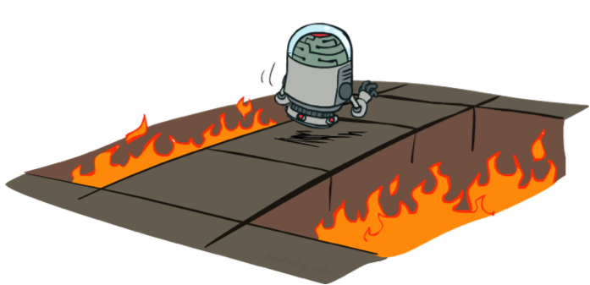
Active Reinforcement Learning
Full reinforcement learning: optimal policies (like value iteration)
You don’t know the transitions T(s,a,s’)
You don’t know the rewards R(s,a,s’)
You choose the actions now
Goal: learn the optimal policy / values
In this case:
Learner makes choices!
Fundamental tradeoff: exploration vs. exploitation
This is NOT offline planning! You actually take actions in the world and find out what happens…

Slide 30
Q-Value Iteration
Value iteration: find successive (depth-limited) values
Start with V₀(s) = 0, which we know is right
Given V_{k}, calculate the depth k+1 values for all states:
But Q-values are more useful, so compute them instead
Start with Q₀(s,a) = 0, which we know is right
Given Q_{k}, calculate the depth k+1 q-values for all q-states:

Slide 31
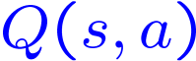
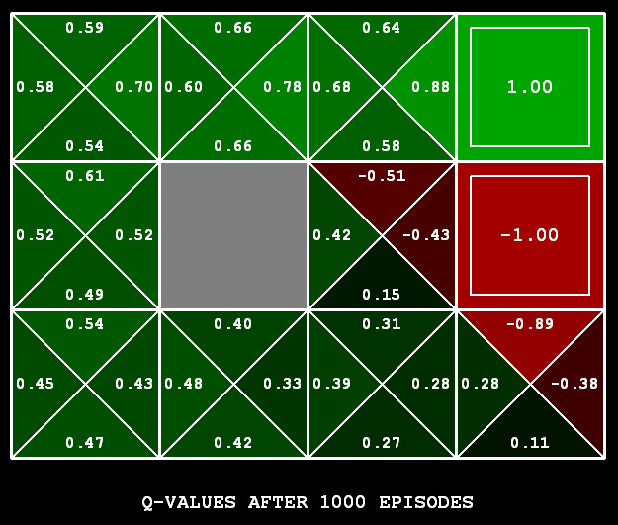
Q-Learning
Q-Learning: sample-based Q-value iteration
Learn Q(s,a) values as you go
Receive a sample (s,a,s’,r)
Consider your old estimate:
Consider your new sample estimate:
Incorporate the new estimate into a running average:
[Demo: Q-learning – gridworld (L10D2)]
[Demo: Q-learning – crawler (L10D3)]

Slide 32

Q-Learning Properties
Amazing result: Q-learning converges to optimal policy -- even if you’re acting suboptimally!
This is called off-policy learning
Caveats:
You have to explore enough
You have to eventually make the learning rate
small enough
… but not decrease it too quickly
Basically, in the limit, it doesn’t matter how you select actions (!)

Slide 33
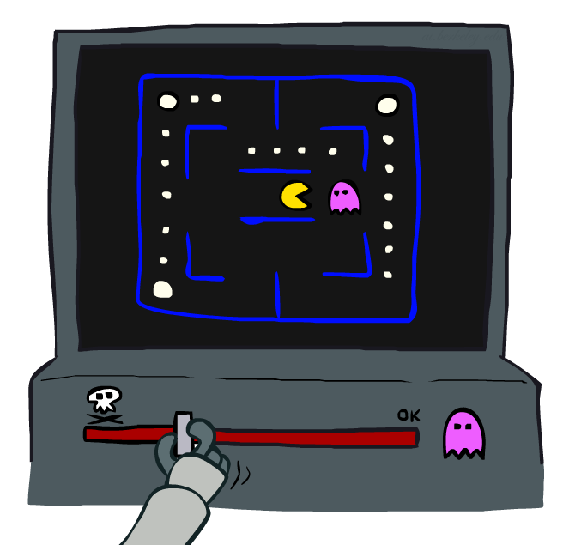
Approximate Q-Learning

Slide 34

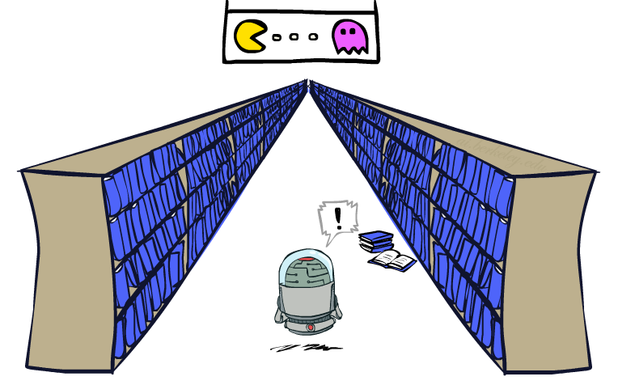
Generalizing Across States
Basic Q-Learning keeps a table of all q-values
In realistic situations, we cannot possibly learn about every single state!
Too many states to visit them all in training
Too many states to hold the q-tables in memory
Instead, we want to generalize:
Learn about some small number of training states from experience
Generalize that experience to new, similar situations
This is a fundamental idea in machine learning, and we’ll see it over and over again
[demo – RL pacman]

Slide 35
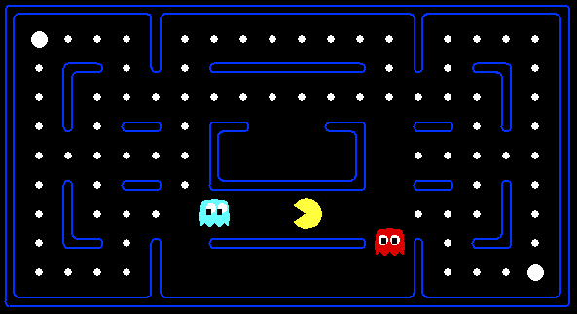



Example: Pacman
Let’s say we discover through experience that this state is bad:
In naïve q-learning, we know nothing about this state:
Or even this one!
[Demo: Q-learning – pacman – tiny – watch all (L11D5)],[Demo: Q-learning – pacman – tiny – silent train (L11D6)], [Demo: Q-learning – pacman – tricky – watch all (L11D7)]

Slide 36
Feature-Based Representations
Solution: describe a state using a vector of features (properties)
Features are functions from states to real numbers (often 0/1) that capture important properties of the state
Example features:
Distance to closest ghost
Distance to closest dot
Number of ghosts
1 / (dist to dot)²
Is Pacman in a tunnel? (0/1)
…… etc.
Can also describe a q-state (s, a) with features (e.g. action moves closer to food)

Slide 37
Linear Value Functions
Using a feature representation, we can write a q function (or value function) for any state using a few weights:
Advantage: our experience is summed up in a few powerful numbers
Disadvantage: states may share features but actually be very different in value!

Slide 38
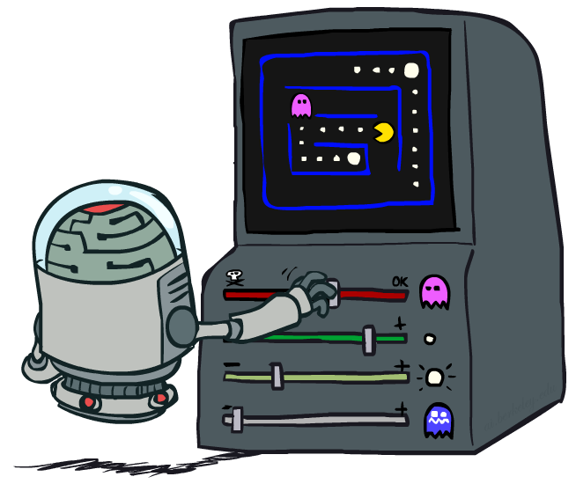
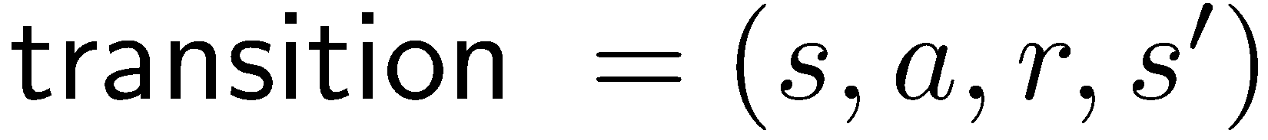
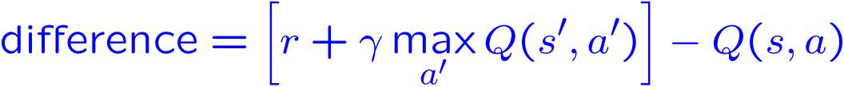
Approximate Q-Learning
Q-learning with linear Q-functions:
Intuitive interpretation:
Adjust weights of active features
E.g., if something unexpectedly bad happens, blame the features that were on: disprefer all states with that state’s features
Formal justification: online least squares
Exact Q’s
Approximate Q’s

Slide 39
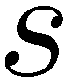
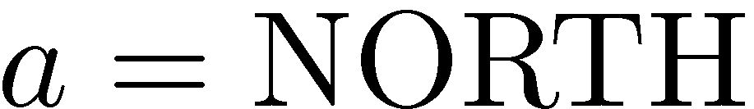
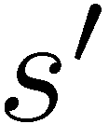
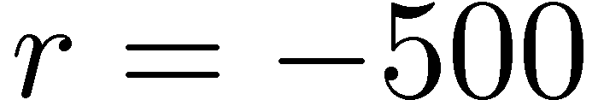
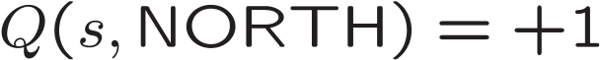
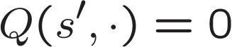
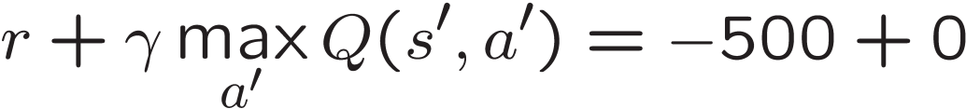
Example: Q-Pacman
[Demo: approximate Q-learning pacman (L11D10)]

Slide 40

Conclusion
We’re done
We’ve seen how AI methods can solve problems in:
Search
Constraint Satisfaction Problems
Games
Markov Decision Problems
Reinforcement Learning

